Slide 1






PowerShell Conference Asia
Build a continuous delivery platform for your PowerShell scripts and modules

Slide 2

Whoami
Azure Architect at Orange Business Services
Rennes City France
MVP Cloud and Datacenter Management
French PowerShell User Group
In love with Docker and Kubernetes
PowerShell Conference
Singapore 2017

Slide 3
Agenda
What is continuous delivery ?
Work in a DevOps world
Version your code
Test your code
Deploy your code
PowerShell Conference
Singapore 2017

Slide 4

PowerShell Conference Asia
What is Continuous Delivery ?

Slide 5
Continuous delivery
“Continuous Delivery doesn't mean every change is deployed to production ASAP. It means every change is proven to be deployable at any time”
by Carl Caum
PowerShell Conference
Singapore 2017

Slide 6
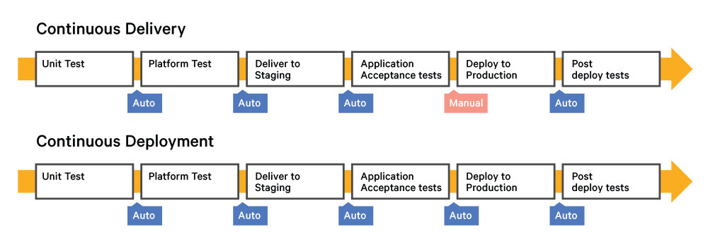
Continuous delivery vs Continous Deployment
Source https://puppet.com/blog/continuous-delivery-vs-continuous-deployment-what-s-diff
PowerShell Conference
Singapore 2017

Slide 7
Fast, automatic… but not without security
Unit testing
Operational testing
Qualimetry
Monitoring
-> THE EMBRASSEMENT OF THE MEASURE CULTURE IS MANDATORY
PowerShell Conference
Singapore 2017

Slide 8

PowerShell Conference Asia
Work in a DevOps world

Slide 9
Visual Studio Team Services
Project gestion
Agile methodology
Charges follow up
Real time reporting
PowerShell Conference
Singapore 2017

Slide 10
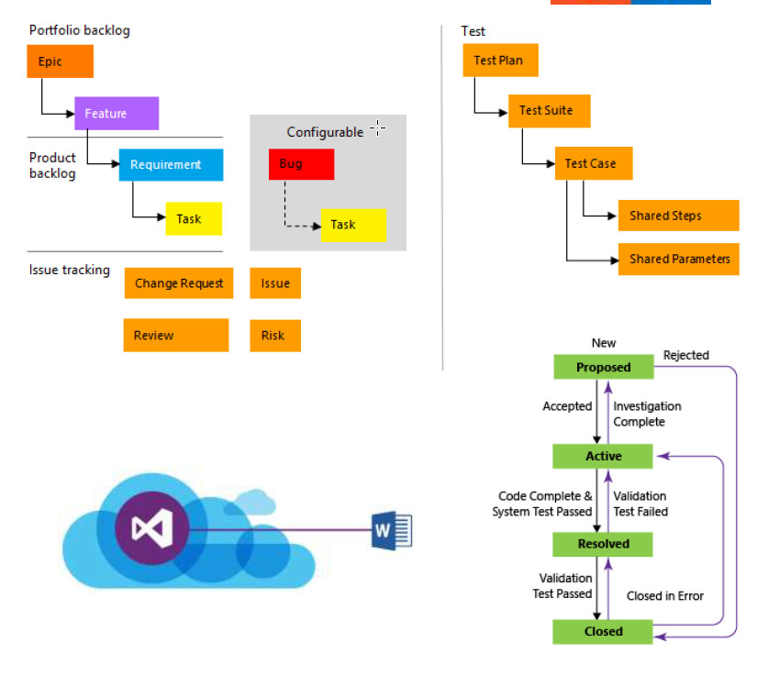
Requirements Management
Centralize requirements in an unique place
Better integration within functional experts
PowerShell Conference
Singapore 2017
Notes:
User story: is a reminder to have a conversation with your customer
Epic: Large body of work, contains stories

Slide 11
Visual Studio Team Services
DEMO
PowerShell Conference
Singapore 2017

Slide 12

PowerShell Conference Asia
Version your code

Slide 13
Gitflow
Git
Flexible code version
Decentralized gestion
Quite bad integration with visual studio (need third party tooling)
Gitflow
Features, release, Hotfix
Automatic versioning
https://gitversion.readthedocs.io/en/latest/git-branching-strategies/gitflow/
Automatic build on specific branch
PowerShell Conference
Singapore 2017

Slide 14
Gitflow
DEMO
PowerShell Conference
Singapore 2017

Slide 15
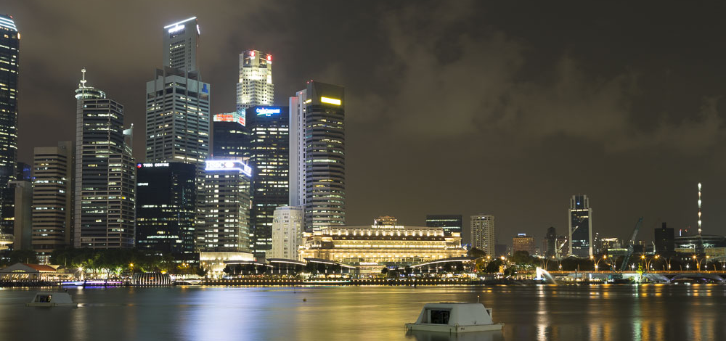
PowerShell Conference Asia
Build your code

Slide 16
Build definition
Workflow that define
Tasks execution order
Execute Pester tests
Deploy artifacts
Publish results
Totally integrated with Azure tenant if you use VSTS
Can be triggered or manual
PowerShell Conference
Singapore 2017

Slide 17
The example
Desired State Configuration script
Updated to answer the developers requirements
Service Bus configuration
PowerShell Conference
Singapore 2017

Slide 18
Build
DEMO
PowerShell Conference
Singapore 2017

Slide 19

PowerShell Conference Asia
Deploy your code

Slide 20
Respect the workflow
Evey steps is important
Do not skip any environment
Use DSC/ARM/Automation to maintain environments
PowerShell Conference
Singapore 2017

Slide 21
The more you test, the less you fail
Use DSC Configuration data file to store all your variables
Pester + Import-PowerShellDataFile = <3
Abuse, abuse and abuse of Pester
Test-DSCConfiguration isn’t enough
PowerShell Conference
Singapore 2017

Slide 22
Release
DEMO
PowerShell Conference
Singapore 2017

Slide 23
Releases follow up
Multi staging possibility
Complete view
Logs
…
PowerShell Conference
Singapore 2017

Slide 24
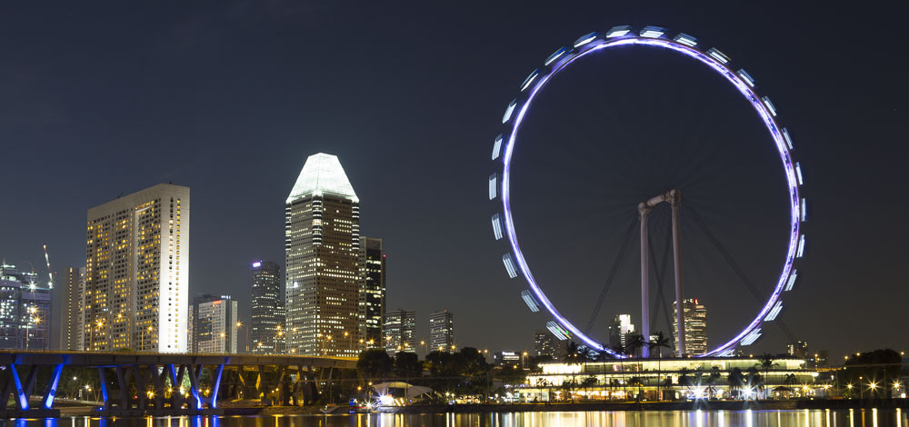
PowerShell Conference Asia
Conclusion

Slide 25
What we learn
Every step is important
Do not skip any environment
Use Automation to maintain environments
They need to be identical !!
Takes long time to get a strong/reliable release pipeline
Use Slack/Teams/Mattermost to communicate with foreign colleagues AND customer
PowerShell Conference
Singapore 2017

Slide 26
Don’t Forget!
Fill in your survey in Mobile app – it’s how we do better!
Don’t lose you badge! You need it for the Social Events
Grab the Speakers for a chat – they all have time for you!
Let everyone know what they are missing on Social Media
#PowerShell
#PSConfAsia
Photos of Marina Bay Credit: Sebastian Szumigalski
PowerShell Conference
Singapore 2017

